Slide 1
DATA QUALITY IN HEALTHCARE
“Operationalizing the Data Quality Framework”
Submitted by-
Sezal Chug (2017101)
Priya Kaushal (2017081)
3rd semester of BTP
Completed Credits: 8
Credits this semester: 4
Under the guidance of-
Dr. Tavpritesh Sethi
Dr. Ponnurangam Kumaraguru
Notes:
Aim was to operationalize data quality framework and build a metric with some data quality parameters which qualitatively and quantitatively define data quality score of a dataset.
We have completed 8 credits each. This our final semester in the BTP consisting for 4 credits each.

Slide 2
AIM
Dataset Nutrition Label Approach
Defining “ingredients” for quantifying a dataset.
Data Quality Label with values of its ingredients
Platform which generates a comprehensive report applied across any dataset domains to judge the quality of data and assign a suitable score using our designed metric.
Applications of Data Quality Metric
Our research aims to formulate a Robust Data Analysis platform which analyzes the quality of dataset and provides the user with
Data Quality Label, Score and a Comprehensive Report.
Notes:
The need for Data Quality emerged from this ever-increasing speed of data growth.
Data quality refers to how suitable the information is for use in a particular application.
With advancements in the technology, use of data has become immensely influential and hence the importance of its quality.
Analyzing the data quality levels can help organizations in identifying errors that need to be resolved so that data can be used to its full potential.
Inaccurate data needs to be identified, documented, and fixed to ensure that proper and efficient usage.
Therefore, data quality has made great strides in research field but it has been largely based on an adoc approach wherein we define data quality not quantify it based on some metric.
We aim to develop this data quality metric that measures the degree to which the provided data is fit to serve our purpose, and further propose algorithms to incorporate data quality assessments.
Applications of the proposed metric would help us understand the validity and reliability.
An online portal would ease the process of generating DQ labels, scores and report.

Slide 3
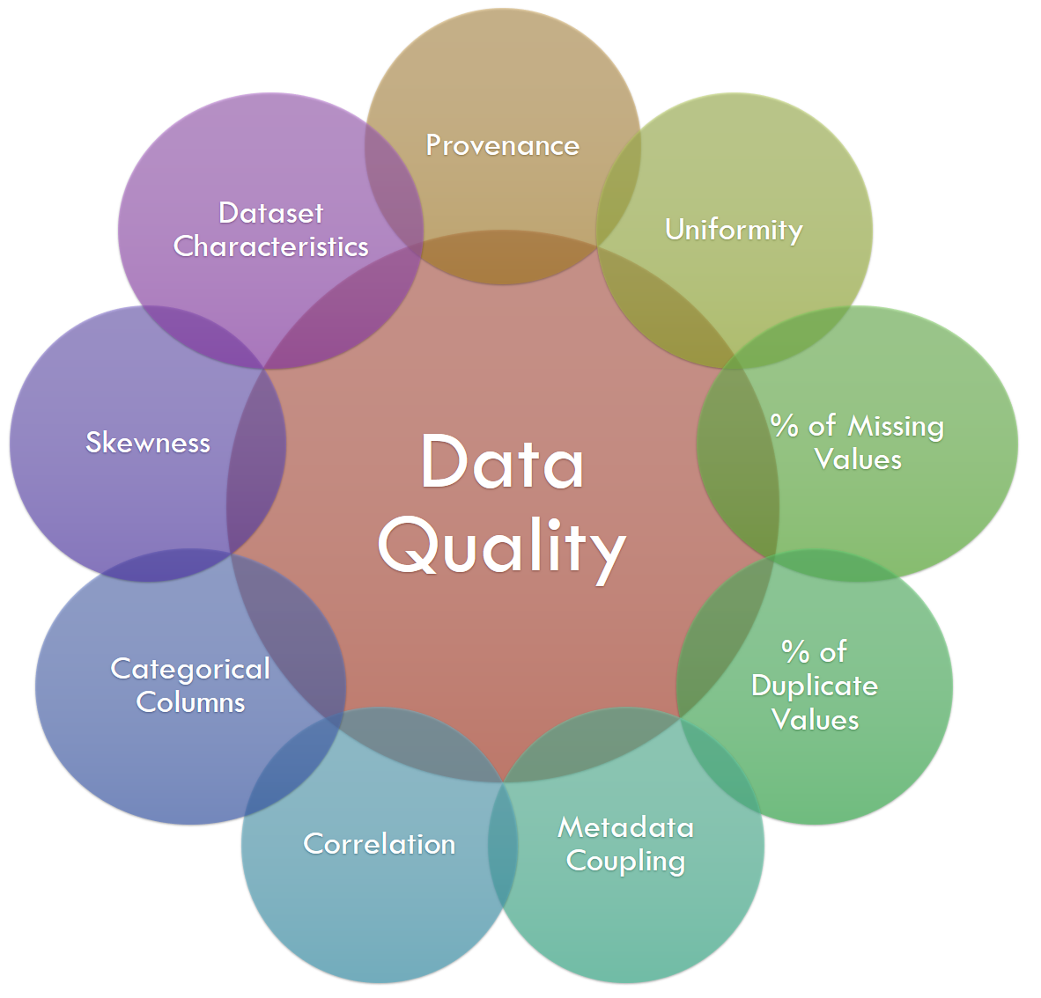
Defining Nutrition Label Ingredients
Notes:
Working on datasets in the Last semester from data.gov.in which is an Open Government Database Platform of India and data.world which is a Global platform, we collected covid datasets from various research healthcare institutes in and around the world. We analyzed these datasets and studied the data quality literature to finalize ingredients that helped us quantify the dataset into aspects which can be measured.
Just to give a brief overview of the ingredients that were in the last semester:
Provenance measure refers to the personal information related to the dataset which specifies the origin, author, version and date uploaded of that particular dataset. While extracting the dataset, we cross-referenced the information regarding these parameters of the dataset and verified them with the ones retrieved by web scraping the source website to generate a score.
Dataset Characterization includes the preliminary checks like mean median, mode, minimum value, and maximum value calculated from the input dataset matched with the values present in the metdata Recode Manual
Uniformity score included the type of data, number of unique values, size of the dataset, and the percentage of categorical data wrt to the total number of variables.
Metadata coupling describes the concordance percentage between the dataset column names and their respective description from the recode manual.
Statistical Modeling of the dataset while calculating the percentage of missing and duplicate cells and skewness of data helped us understand if any kind of bias is present in the data.
Correlation coefficients helped measure the strength of the relationship between two variables.

Slide 4
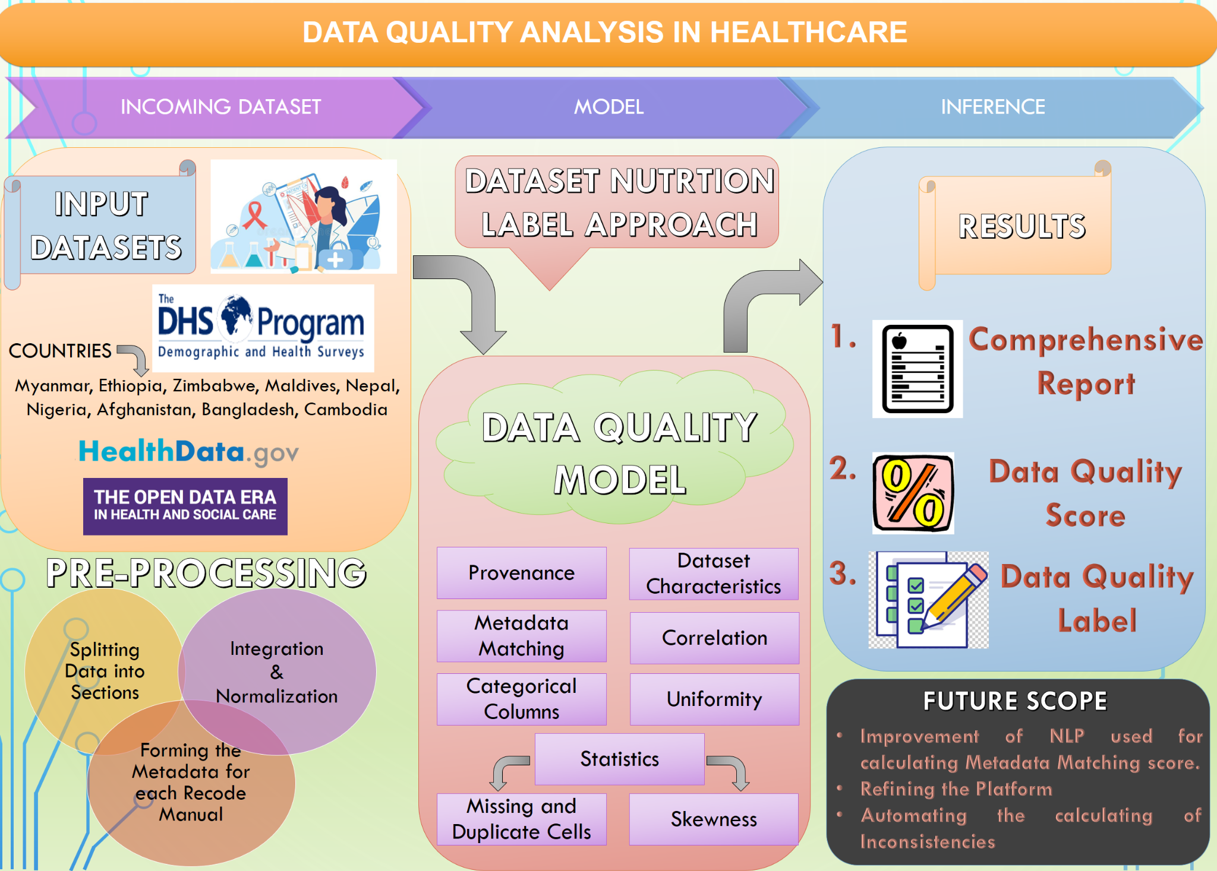
Research Methodology
Notes:
In this semester, we quantitatively defined metric to illustrate the data quality ingredients and scores of various datasets taken as training data which will be discussed further.
We preprocessed the data by splitting into sections wherever necessary, generated the metadata by reading pdfs or web scraping the sources and integrated and normalized the retrieved data to pass it into our model which generated values if the earlier defined ingredients, a comprehensive report including these values and suggestions on how to improve DQ and DQ score.
These suggestions would include, instances where the cols are highly correlated or skewed. Row numbers where we found missing data or duplicate values. Information about the author which was missing such as the last updated date or version number. Etc.
We have also created a data quality platform which will take user input dataset and metadata and automatically generate these three deliverables.

Slide 5
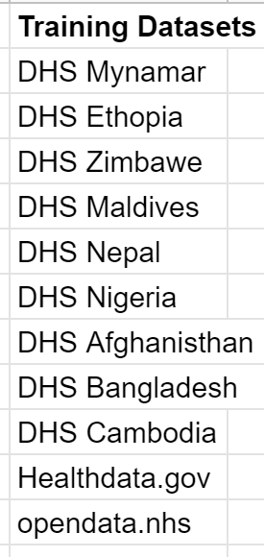



Dataset Retrieval
DHS data for the year 2015-16 for Myanmar, Ethiopia, Zimbabwe, Maldives, Nepal, Nigeria, Afghanistan, Bangladesh and Cambodia.
Government Health Data (https://healthdata.gov)
Health and Social Care Open Data platform (https://www.opendata.nhs.scot/)
Data Quality Database
https://docs.google.com/spreadsheets/d/13jXGvzRNS3YbxiMeodIhZBkNQiKG3cwwhDrEoSvGlqI/edit?usp=sharing
Notes:
As there was no available dataset which gave us the value of all the data quality parameters along with data quality, we collected around 200 datasets using DHS data for the year 2015-16 for Myanmar, Ethiopia, Zimbabwe, Maldives, Nepal, Nigeria, Afghanistan, Bangladesh and Cambodia ,Government Health Data (https://healthdata.gov) and Health and Social Care Open Data platform (https://www.opendata.nhs.scot/).
The link of the dataset is in the slides

Slide 6
Formulation of
Data Quality Metric

Slide 7
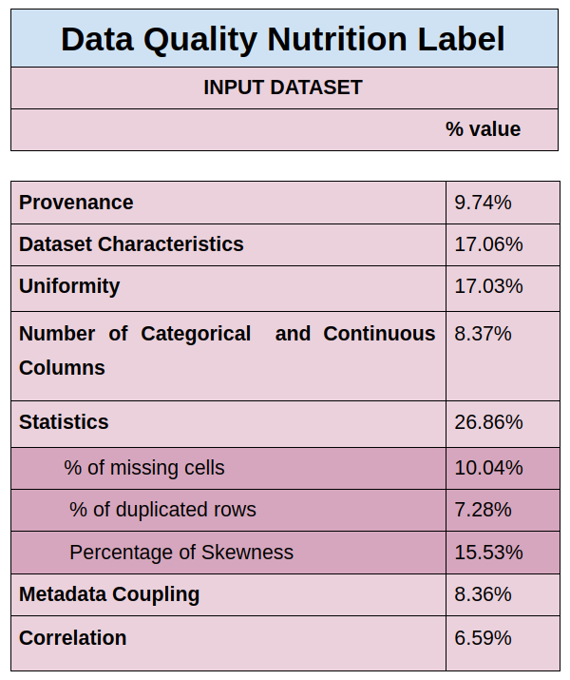
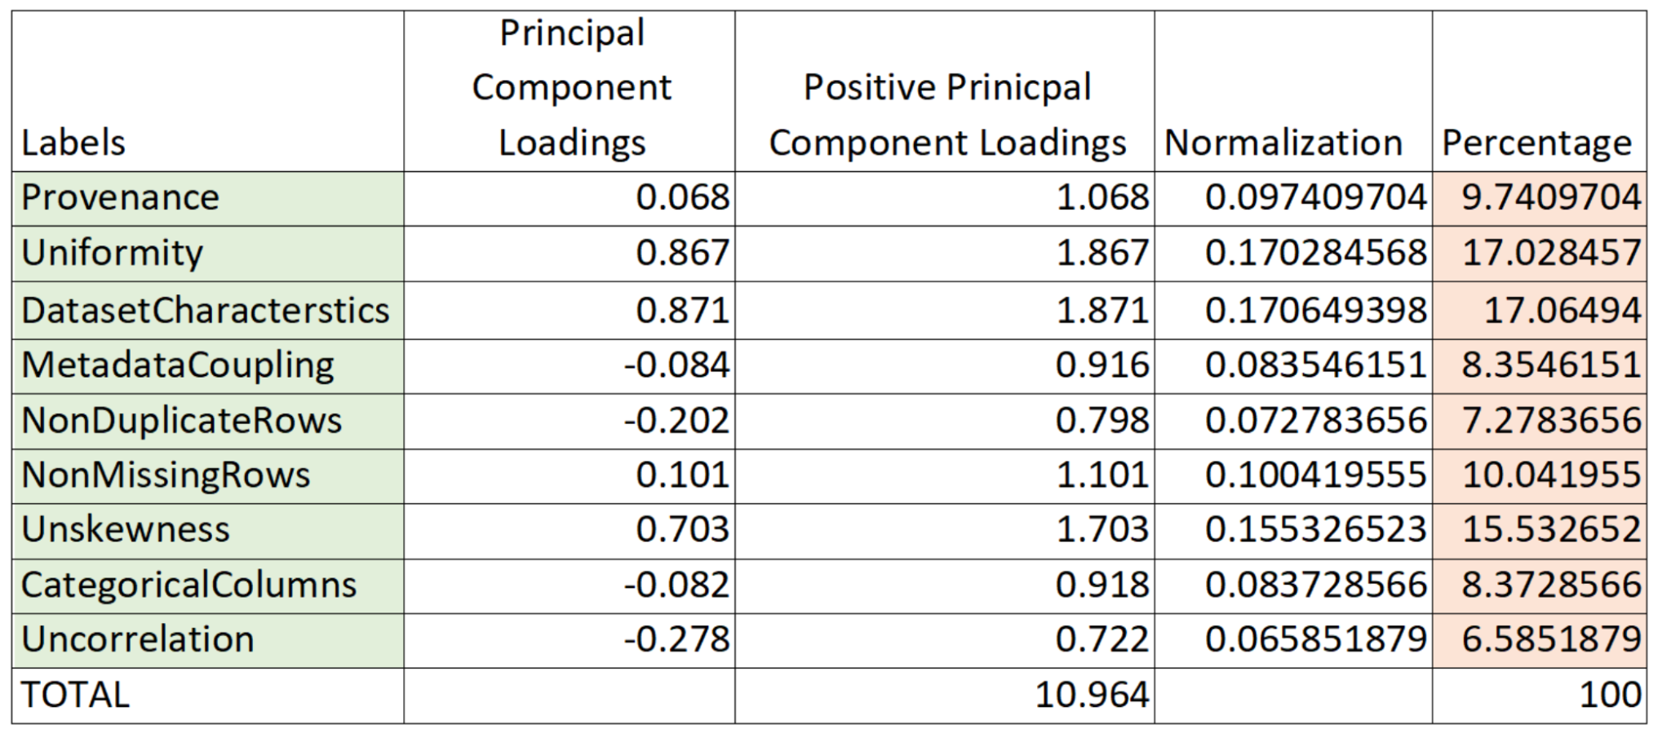
Principal Component Analysis Metric
Principal Component Analysis (PCA) is used to calculate the principal components loadings of dataset.
Positive and Negative Loadings
Shift in Offset
Normalization
Notes:
First line from slide.
The loadings can be positive or negative depending on the variable indicating positive or negative correlation.
Positive loadings indicate a positive correlation between the variable and the principal component.
Negative loadings indicate a negative correlation.
Higher the value of loading, the stronger is the effect of the variable.
Considering the first principal loadings for our study, we shifted the offset of these values from [-1,1] to [0,2] by adding 1 to all principal component loadings to make all values positive.
Normalizing these loadings we retrieve the percentage of each “ingredient”.
The results of this analysis helped us make a data quality label shown in the viewfoil.

Slide 8
Similarity Metric
Cosine Similarity Score
Data Quality Values
Training Dataset
Linear Regression
Data Quality Metric
Cosine Similarity score between vectors of i^{th} dataset and the ideal dataset.
Approximate Data Quality value for each dataset by subtracting the cosine similarity score from 100.
Formulating the Training dataset which includes Data Quality ingredients as independent variables and Data Quality Scores as dependent variable.
Coefficient for each ingredient using the Linear Regression
Data Quality Metric through these coefficients.
Notes:
to check correctness of our proposed metric, we decided to test the same with another approach to see if we get similar results for each data quality parameters.
In an ideal world a dataset will have a data quality score of 100, with the values of provenance, uniformity,dataset characteristics 100, 100% metadata matching, no duplicates or missing values etc.
We calculated the cosine similarity between the vectors of all the datasets in training data with the ideal dataset to get an approximate data quality. Now this formulated dataset included Data Quality ingredients as independent variables and Data Quality Scores as dependent variable.
Then we applied linear regression model to this dataset to get the coefficient of each ingredient and built a data quality metric.

Slide 9
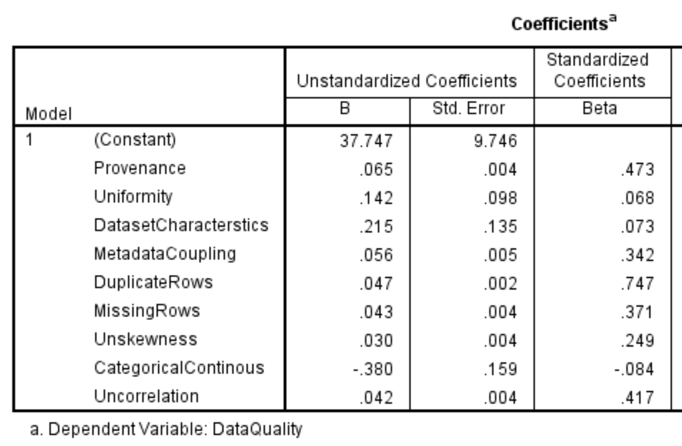
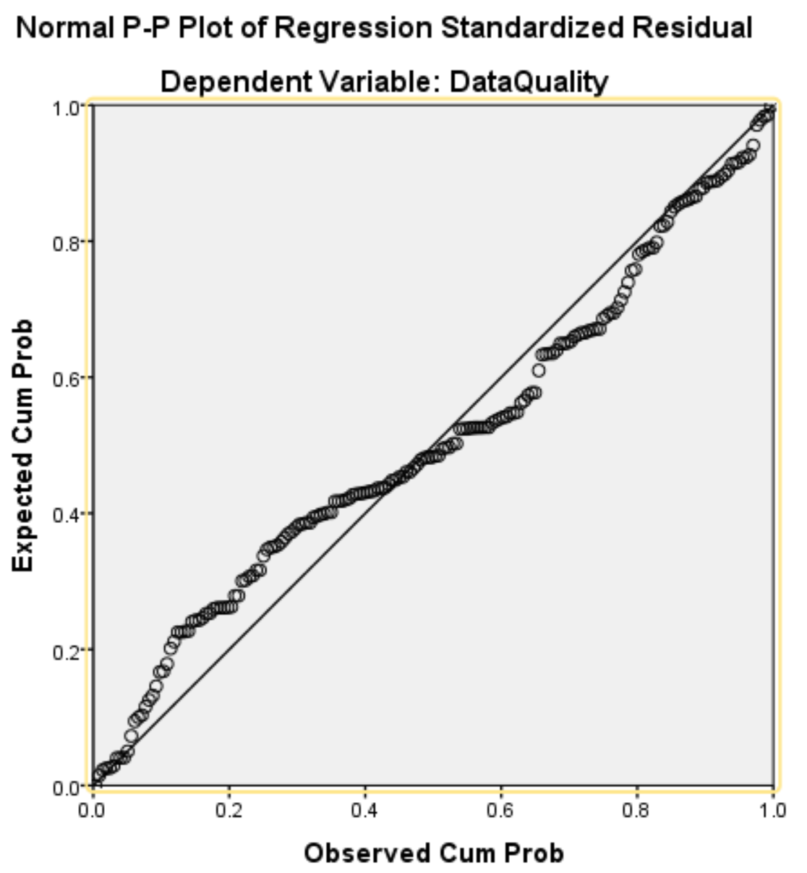
Weightages using Linear Regression
Notes:
In this slide we can see the results of linear regression.
The Value of B in unstandardised coeff show the weight of each ingredient.
On the right side we can see the scatter plot.

Slide 10
Application of Proposed Metric
Notes:
Moving on to some of the applications which empirically show the correctness of our proposed metric

Slide 11
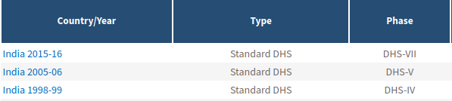
Testing Dataset
The Demographics and Health Surveys (DHS) Program dataset over the years 1998-99, 2005-06 and 2015-16 was used as testing data and was evaluated using the Data Quality Platform on all the parameters.
We observe a constant increase in the data quality scores over the years 1998-99, 2005-06 and 2015-16 in almost all sections justifying the hypothesis that Data Quality is increasing with the advancement of technology.
Notes:
As an application of our data quality metric we performed a case study using the DHS India dataset over the years 1998-99, 2005-06 and 2015-16 as testing data and evaluated the data quality using our metric and platform.
After observing the data quality parameters for each year we see a constant increase in the data quality scores over the years 1998-99, 2005-06 and 2015-16 in almost all sections justifying the hypothesis that Data Quality is increasing with the advancement of technology.

Slide 12
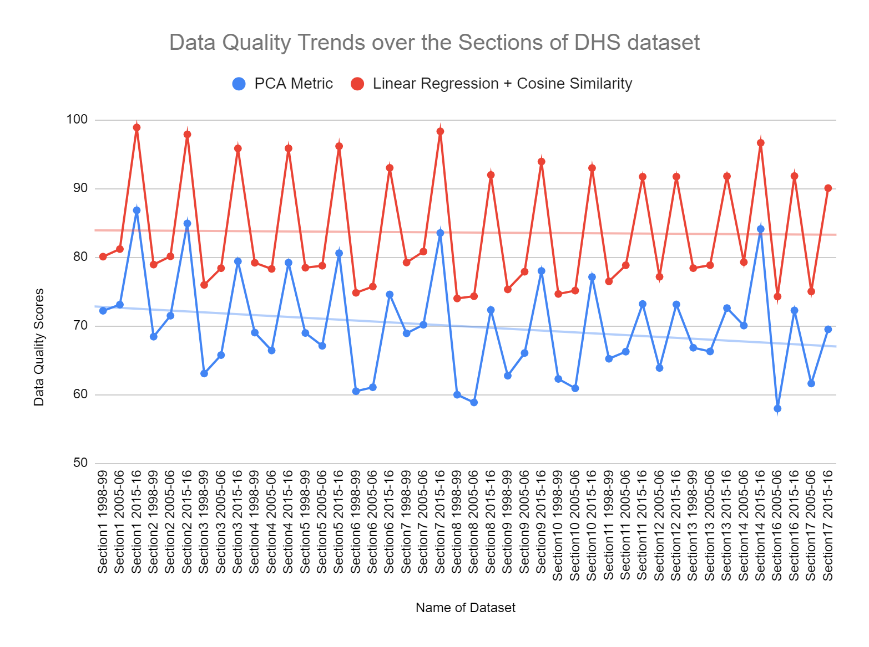
Trends of Data Quality

Slide 13
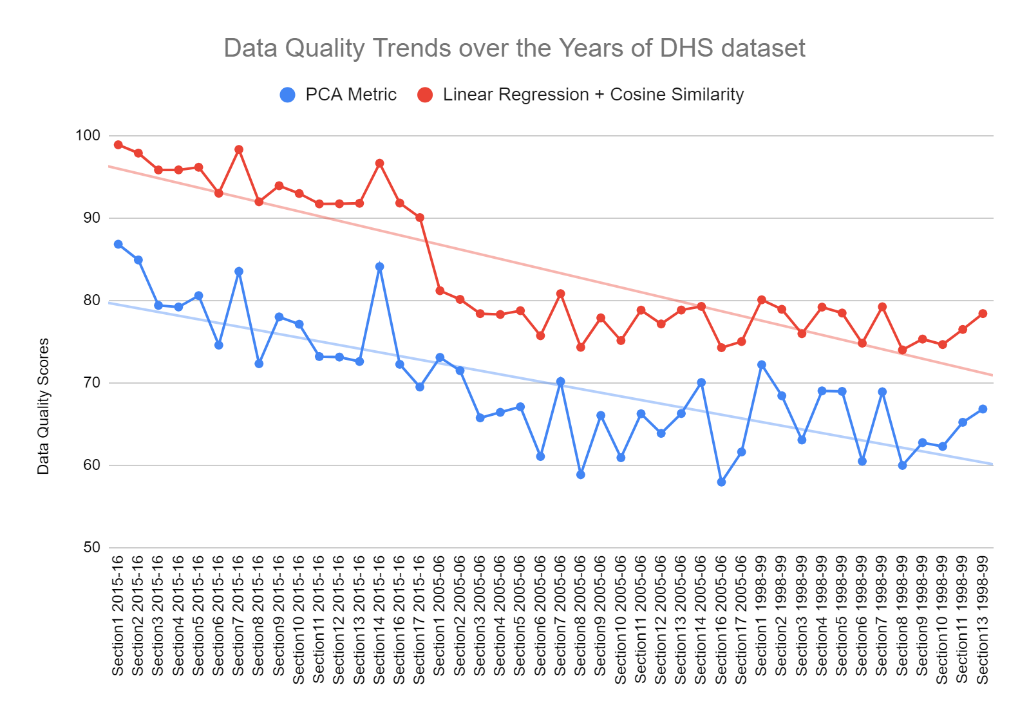
Trends of Data Quality

Slide 14
Trends of Data Quality
The similarity in trends prove that data quality is independent of the metric and can be accurately captured by the ingredients proposed by the study.
Observation: The increase and decrease of data quality with respect each dataset and show similar trends.
Principal Component Analysis is considered a standard and reliable metric for calculating the weights of each parameter instead of the Linear Regression approach due to its widely accepted parametric.
Notes:
In the graphs, we observe that the increase and decrease of data quality with respect each dataset and observe similar trends. The similarity in trends prove that the data quality is independent of the metric and can be accurately captured by the ingredients proposed by the study.
In order to finalise one metric for getting the final data quality scores, we used the weights calculated after PCA analysis of the dataset as PCA is standard
and reliable metric.The approach of cosine similarity to get the dependent variable doesnt give us accurate results and hence is unreliable.

Slide 15
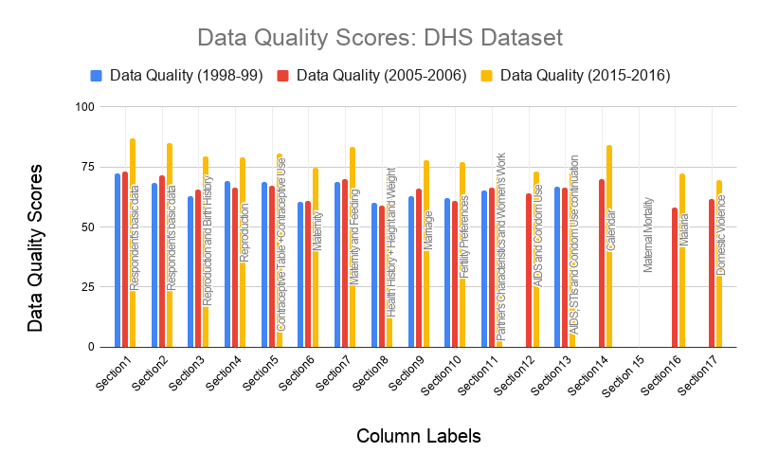
Case Study: DHS Indian Datasets
Notes:
PCA metric above testing set of DHS Indian dataset the years ----
Explain the graph
Consistent increase everyyear

Slide 16
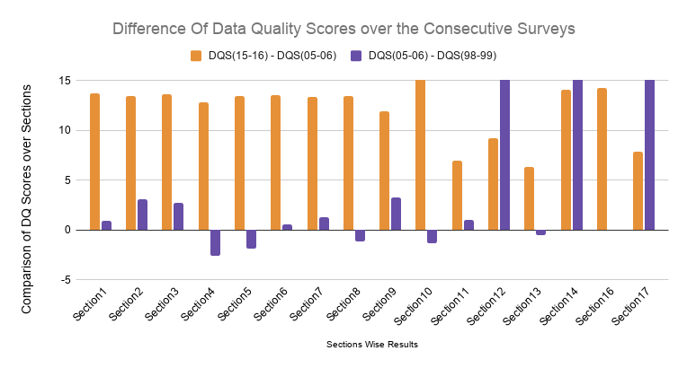
Case Study: DHS Indian Datasets
Notes:
Most of the difference values are positive with the exception of section 4 and 5 where there is a decrease in dataquality, the difference being ⅔% only.

Slide 17
Creating Synthetic Datasets
AIM: To analyse the effectiveness of the proposed metric and to observe the change in values of data quality with respect to change in values of ingredients.
Negative Noise: Adding
missing cells
duplicate row samples
highly correlated columns
skewness to the dataset by removing some category in a column
making the metadata worse.
Positive noise: Removing
missing cells
duplicate rows
Improving metadata
removing highly correlation between columns
Making continuous columns categorical
Notes:
To analyse the effectiveness of the proposed metric, the study suggested to observe the change in values of data quality with respect to change in values of ingredients.
This helped to check if our model captures the difference between a dataset with good and bad data quality.
Taking a few datasets from Kaggle, we performed the above experiment and observed values of data quality score changing over the type of noise that was added to the data.
For every dataset, 10 other datasets were created by adding one type or multiple noise sources.
Negative Noise was inserted in the form of adding missing cells, duplicate row samples, highly correlated columns, skewness to the dataset by removing some category in a column, and making the metadata worse.
• Positive noise was added in the form of removing missing cells, duplicate rows, making the metadata better, removing correlation between columns, and making continous columns categorical.

Slide 18
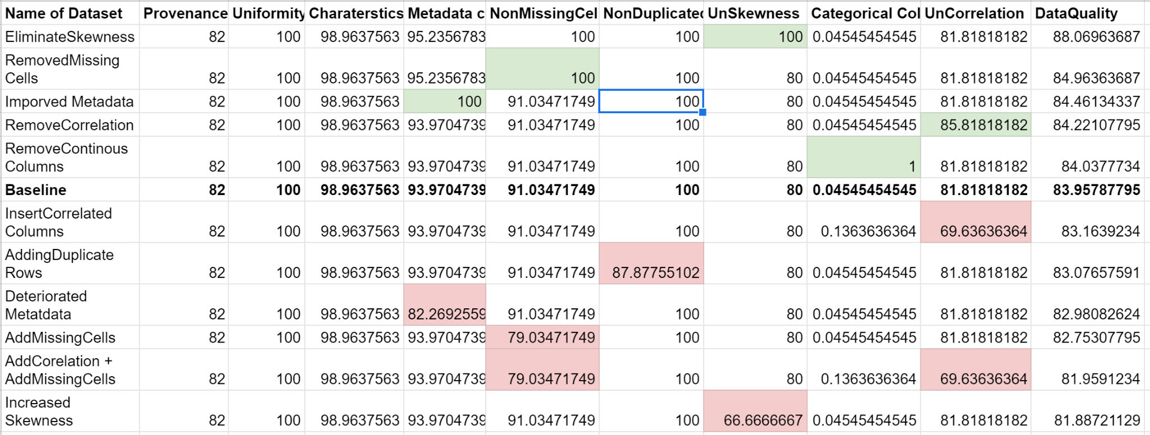
Creating Synthetic Datasets
Green: Positive Noise
Red: Negative Noise
Kaggle: Life Expectancy (WHO), Statistical Analysis on factors influencing Life Expectancy
Author: Kumar Rajarshi, updated 3 months ago (Version 3)
Link: https://www.kaggle.com/kumarajarshi/life-expectancy-who
Notes:
For an example, we have taken Life expectancy dataset from kaggle, updated about 3 months ago. Link is also give.
Baseline in bold.
Green are the cells where we added positive noise thereby increasing data quality score from the baseline
Red are the cells where we added negative noise thereby decreasing data quality score from the baseline

Slide 19
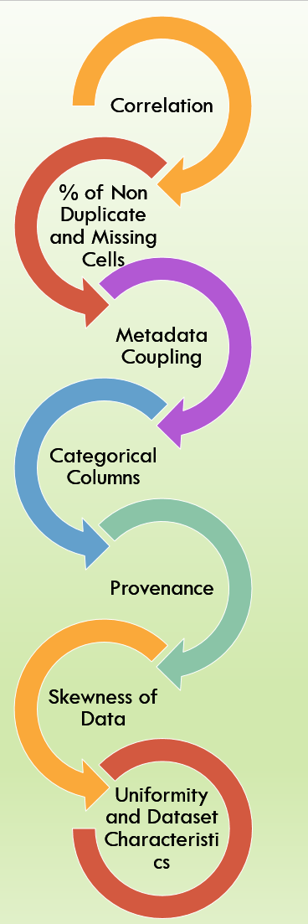
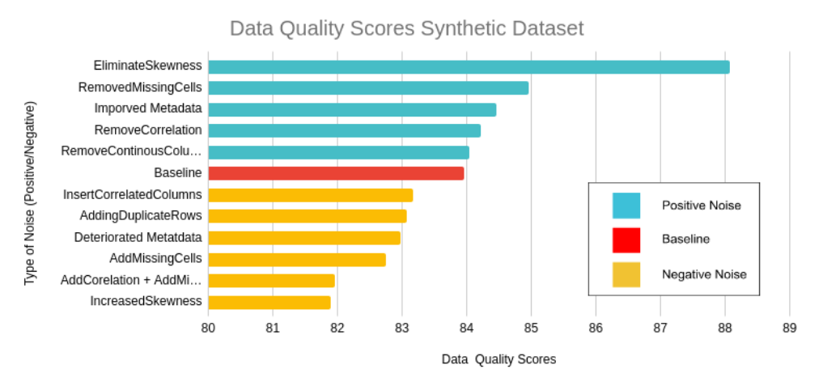
Creating Synthetic Datasets: DQ Comparison
Sorting of DQ ingredients wrt to PCA Metric values
Notes:
The data quality for the baseline and its modified datasets was calculated and compared as shown in figure
We observed that the data quality of the datasets created by adding negative noise decreased and increased after adding positive noise as compared to the original baseline dataset. These observations prove that our metric can capture the data quality trend for all kinds of datasets correctly and in concordance with the weightage of ingredients.
The weightages are given in the diagram on the right, where it is visible that after correlation, comes % duplicate cells and then metadata and further missing cells. Which is in the same sequence as the green bars and yellow bars that show positive and negative noise respectively.

Slide 20
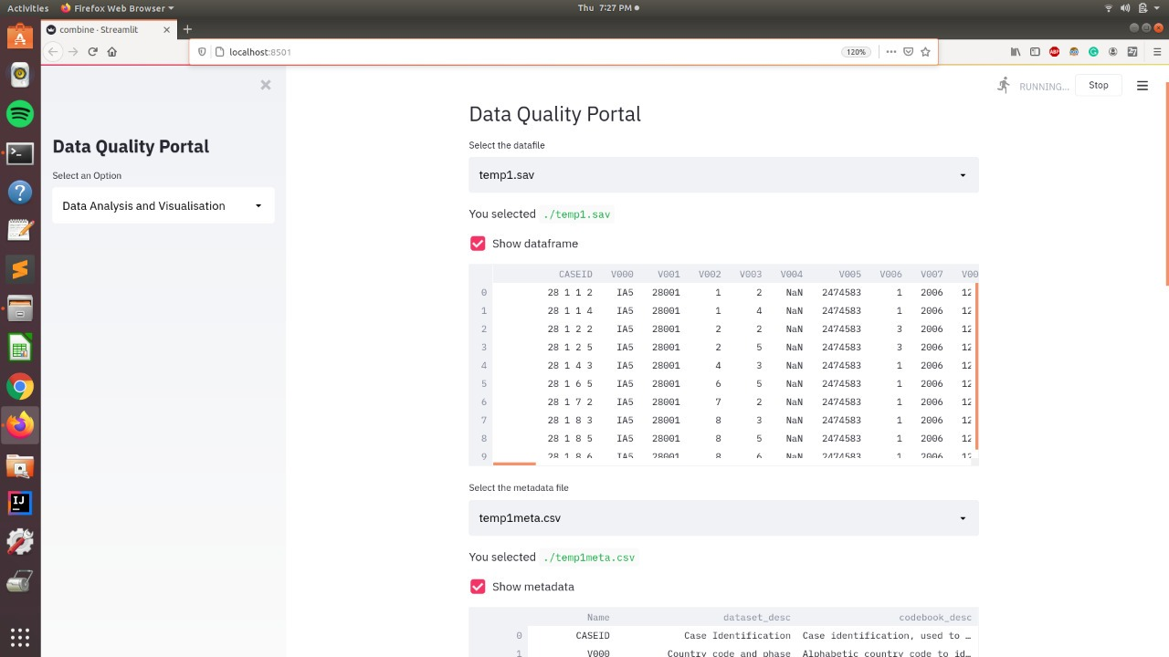
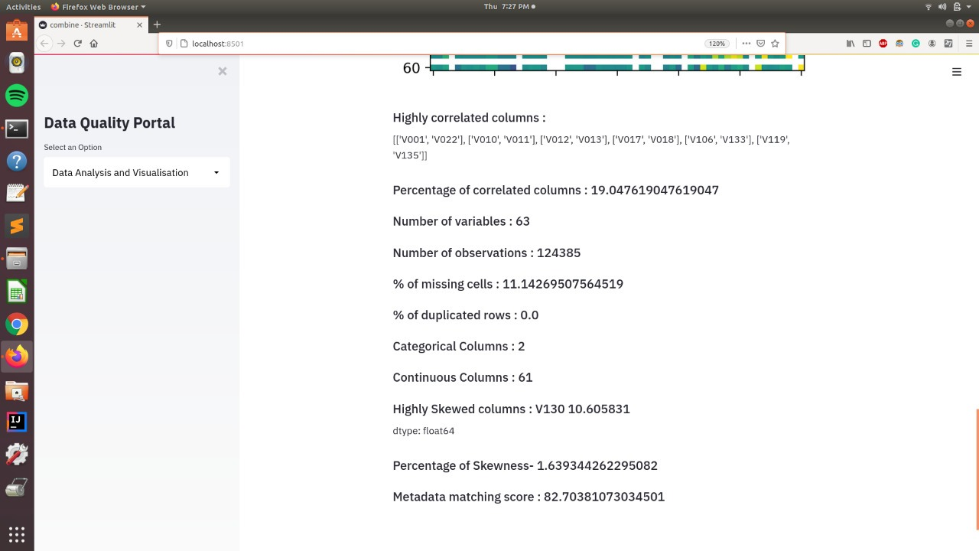

Data Quality Portal
AIM: Generate Data Quality Label, Score and a comprehensive report
Uploading Dataset and Metadata
Data Quality Ingredients
About the Metric

Slide 21
Conclusion
Assessing data quality is an ongoing effort
Subjective and Objective Assessments of data quality in terms of scores
Formulating Data Quality Metrics
Applications of proposed Data Quality Metric
Data Quality Portal
Data Quality Label
Data Quality Score
Comprehensive Report
“This research could be the first step in a broader effort toward data quality.”
Notes:
Increased use of data has urged the need for quality data for decision making. Hence data quality checks and their interpretation has become the need of the hour.
Assessing data quality is an on-going effort that requires awareness of the fundamental principles underlying the development of subjective and objective data quality metrics.
In our research, we represent frameworks in terms of scores generated that check the quality of data.
We have developed illustrative metrics for important data quality dimensions.
Finally, we have presented an approach that provides flexibility, scalability, and adaptability.
We have shown places where the proposed metric has proved its accuracy and concordance.
Applications of Formulated Metric
Case Study: DHS Datasets over the years
Data Quality Trends
Numerous synthetic datasets with varying data quality scores and to observe trends with respect to adding and removing noise.
Data Quality Portal
This research could be the first step in a broader effort toward improving data quality.

Slide 22


Professors in the Project
Undergraduate Students in the Project
Dr. Ponnurangam Kumaraguru
Professor
Computer Science Engineering
Indraprastha Institute of Information Technology New Delhi
Dr. Tavpritesh Sethi
Assistant Professor
Computational Biology
Indraprastha Institute of Information Technology New Delhi
Sezal Chug : BTech | CSE
Roll Number : 2017101
Priya Kaushal : BTech | CSE
Roll Number : 2017081
THANK YOU

